Slide 1
Chapter 1 – Databases and Databases Users

Slide 2
- Introduction
- Characteristics of Database Approach
- Advantages Of Using DBMS
- When Not To Use DBMS
- Files vs. Databases
Content

Slide 3
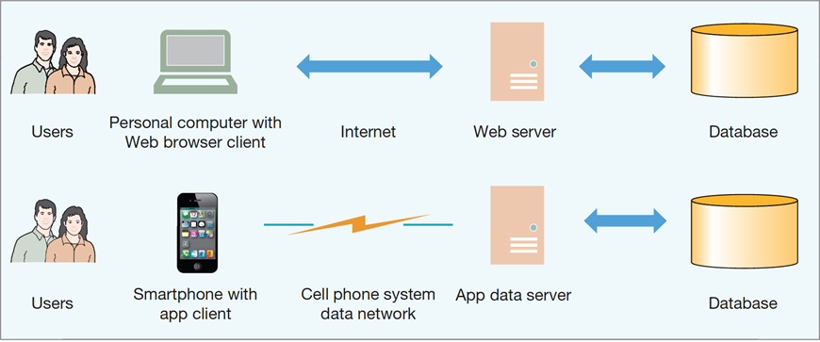
Users Are Dependent on Databases
The Internet and Mobile Device World

Slide 4




Introduction
Databases are an essential component of life in modern society.
Traditional database applications: Most of the information that is stored and accessed is either textual or numeric.
Social media websites, such as Facebook, Twitter, among many others
  has required the creation of huge databases that store nontraditional data, such as posts, tweets, images, and video clips.
  New types of database systems, often referred to as NOSQL systems, have been created to manage data for social media applications.
  Deposit or withdraw
  funds
  Making a hotel or airline reservation
  Access a computerized library catalog
  Purchase something online

Slide 5
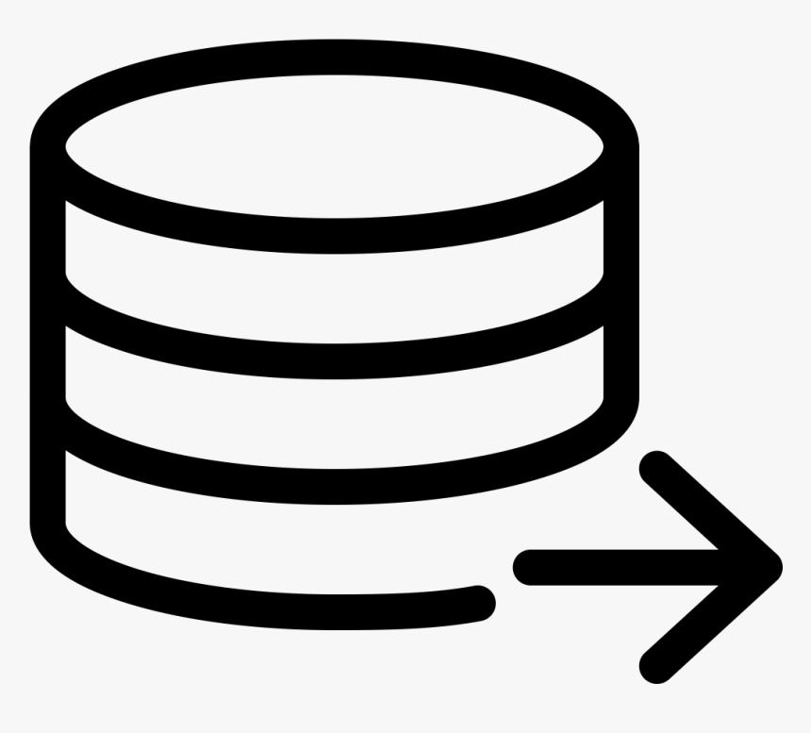


Introduction
Database - collection of related data.
Data means known facts that can be recorded and that have some meaning.
For example, mobile phones have their own simple database software and typically store the following data:
  Names, Telephone numbers and Addresses of the people
A database has
A database can be of any size and complexity.
  For example, the list of names and addresses may consist of only a few hundred records.
  A database of even greater size and complexity would be maintained by a social media company such as Facebook, which has more than a billion users.
Some source from which data is derived
Degree of interaction with events in the real world
An audience interested in its contents

Slide 6
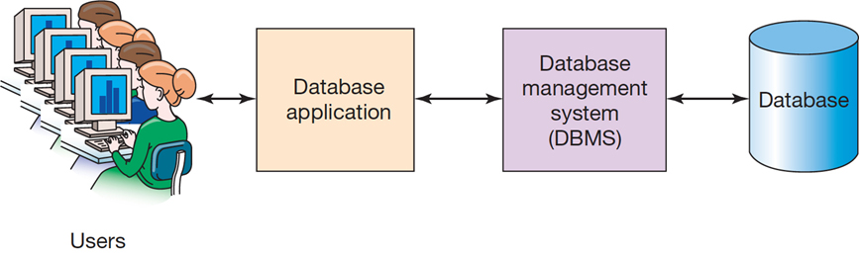
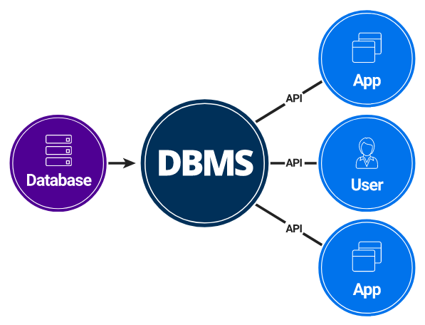
Introduction
A database management system (DBMS) is a computerized system that enables users to create and maintain a database.

Slide 7
Introduction
DBMS - General-purpose software system that facilitates the processes of:
1
Defining
Defining a database involves specifying:
Data types, Structures and Constraints of the data.
Meta-data - The database definition stored by the DBMS in the form of a database catalog or dictionary.
2
Constructing
Process of storing the data on some storage medium that is controlled by the DBMS.
3
Manipulating
Includes functions such as querying the database to retrieve specific data, updating the database and generating reports.
4
Sharing
Allows multiple users and programs to access the database simultaneously.
An application program accesses the database by sending queries or requests for data to the DBMS.

Slide 8
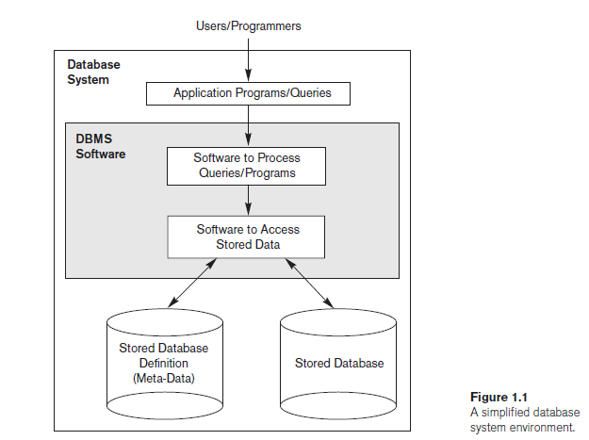
Introduction
Other important functions provided by the DBMS include protecting the database and maintaining it over a long period of time.
  Protection - system protection against software malfunction (or crashes) and security protection against unauthorized or malicious access. (ACID Durability, RBAC (Role-Based Access Control)
  Maintenance - A typical large database may have a life cycle of many years, so the DBMS must be able to maintain the database system by allowing the system to evolve as requirements change over time. (Logical and Physical Data Independence)

Slide 9
Functions of a D B M S
Create database
Create tables
Create supporting structures (e.g., indexes)
Read database data
Modify (insert, update, or delete) database data
Maintain database structures
Enforce rules
Control concurrency
Provide security
Perform backup and recovery

Slide 10

Characteristics of Database Approach
Traditional file processing - each user defines and implements the files needed for a specific software application as part of programming the application.
Both users are interested in data about students but each user maintains separate files.
This redundancy in defining and storing data results in wasted storage space.
USER 1
Grade reporting office
Keep files on students and their grades
USER 2
Accounting office
Keep track of students’ fees and their payments

Slide 11
Characteristics of Database Approach
In the database approach, a single repository maintains data that is defined once and then accessed by various users repeatedly through queries, transactions, and application programs.
The main characteristics of the database approach versus the file-processing approach are the following:
  Self-describing nature of a database system
  Insulation between programs and data, and data abstraction
  Support of multiple views of the data
  Sharing of data and multiuser transaction processing

Slide 12
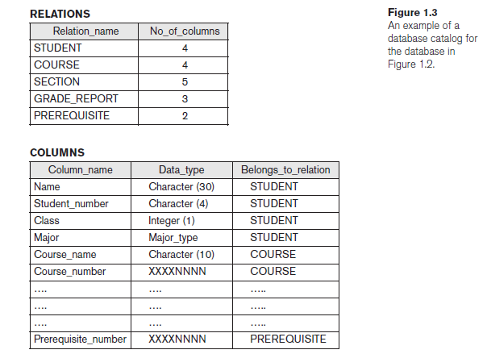
Characteristics of Database Approach
Self-Describing Nature of a Database System
A database system contains not only the database itself but also a complete definition of the database structure and constraints.
Definition stored in the DBMS catalog contains information such as:
  the structure of each file,
  the type and storage format of each data item,
  and various constraints on the data.
The information stored in the catalog is called meta-data.
Whenever a request is made to access, say, the Name of a STUDENT record, the DBMS software refers to
  the catalog to determine the structure of the STUDENT file
  and the position and size of the Name data item within a STUDENT record.

Slide 13
Characteristics of Database Approach
Insulation between programs and data, and data abstraction
Data abstraction - The characteristic that allows program-data independence.
A DBMS provides users with a conceptual representation of data that does not include many of the details of how the data is stored or how the operations are implemented.
Data model - a type of data abstraction that is used to provide this conceptual representation and hides storage and implementation details.
Traditional File Processing | DBMS
The structure of data files is embedded in the application programs, so any changes to the structure of a file may require changing all programs that access that file. | DBMS access programs do not require such changes in most cases. The structure of data files is stored in the DBMS catalog separately from the access programs known as program-data independence.

Slide 14
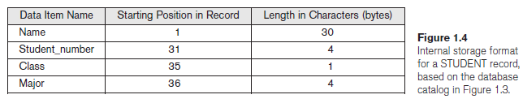
Characteristics of Database Approach
Insulation between programs and data, and data abstraction
For example, a file access program may be written in such a way that it can access only STUDENT records of the structure shown.
If we want to add another piece of data to each STUDENT record, say the Birth_date, such a program will no longer work and must be changed.
In a DBMS environment, we only need to change the description of STUDENT records in the catalog to show the new data item Birth_date; no programs are changed.

Slide 15
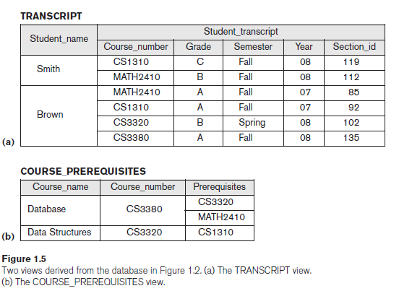
Characteristics of Database Approach
Support of Multiple Views of the Data
View - a subset of the database or it may contain virtual data that is derived from the database files but is not explicitly stored.
A multiuser DBMS whose users have a variety of distinct applications must provide facilities for defining multiple views.
For example:
  One user of the database may be interested only in accessing and printing the transcript of each student; the view for this user is shown in Figure 1.5(a).
  A second user, who is interested only in checking that students have taken all the prerequisites of each course for which the student registers, may require the view shown in Figure 1.5(b).

Slide 16
Characteristics of Database Approach
Sharing of Data and Multiuser Transaction Processing
A multiuser DBMS, must allow multiple users to access the database at the same time.
The DBMS must include concurrency control software to ensure that several users trying to update the same data do so in a controlled manner so that the result of the updates is correct.
  For example, when several reservation agents try to assign a seat on an airline flight, the DBMS should ensure that each seat can be accessed by only one agent at a time for assignment to a passenger.
Transaction - An executing program or process that includes one or more database accesses, such as reading or updating of database records.
The DBMS must enforce several transaction properties.
  Isolation - ensures that each transaction appears to execute in isolation from other transactions, even though hundreds of transactions may be executing at the same time.
  Atomicity - ensures that either all the database operations in a transaction are executed or none are.

Slide 17
Advantages Of Using DBMS
Controlling Redundancy
In traditional software development using file processing, every user group maintains its own files for handling its data-processing applications.
This redundancy in storing the same data multiple times leads to several problems.
  1. Need to perform a single logical update such as entering data on a new student multiple times, once for each file where student data is recorded. This leads to duplication of effort.
  2. Storage space is wasted when the same data is stored repeatedly.
  3. Files that represent the same data may become inconsistent. This may happen because an update is applied to some of the files but not to others. Even if an update—such as adding a new student—is applied to all the appropriate files, the data concerning the student may still be inconsistent because the updates are applied independently by each user group.
    For example, one user group may enter a student’s birth date erroneously as ‘JAN-19-1988’, whereas the other user groups may enter the correct value of ‘JAN-29-1988’.

Slide 18
Advantages Of Using DBMS
Restricting Unauthorized Access
When multiple users share a large database, most users will not be authorized to access all information in the database.
  For example, financial data such as salaries and bonuses is often considered confidential, and only authorized persons are allowed to access such data.
A DBMS should provide a security and authorization subsystem, which the DBA uses to create accounts and to specify account restrictions.
  For example, only the DBA’s staff may be allowed to use certain privileged software, such as the software for creating new accounts.

Slide 19
Advantages Of Using DBMS
Providing Storage Structures and Search Techniques for Efficient Query Processing
The DBMS must provide specialized data structures and search techniques to speed up disk search for the desired records.
Indexes are often used for this purpose.
  Indexes are typically based on tree data structures or hash data structures that are suitably modified for disk search.
The query processing and optimization module of the DBMS is responsible for choosing an efficient query execution plan for each query based on the existing storage structures.
Providing Backup and Recovery
The backup and recovery subsystem of the DBMS is responsible for recovery.
  For example, if the computer system fails in the middle of a complex update transaction, the recovery subsystem is responsible for making sure that the database is restored to the state it was in before the transaction started executing.

Slide 20
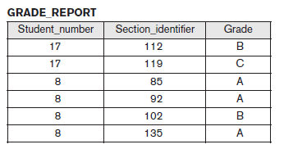
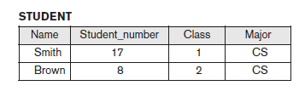
Advantages Of Using DBMS
Providing Multiple User Interfaces
Many types of users with different levels of technical knowledge use a database, so a DBMS should provide a variety of user interfaces that include:
  apps for mobile users,
  query languages for casual users,
  programming language interfaces for application programmers,
  forms and menu-driven interfaces for standalone users.
Representing Complex Relationships among Data
A database may include many varieties of data that are interrelated in many ways.
The record for ‘Brown’ in the STUDENT file is related to four records in the GRADE_REPORT file.

Slide 21
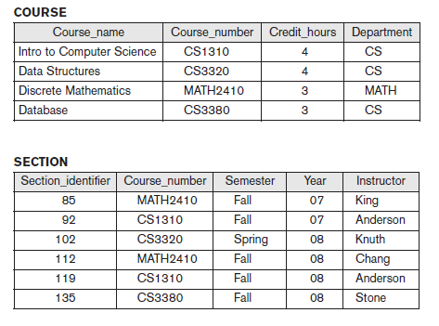
Advantages Of Using DBMS
Enforcing Integrity Constraints
Most database applications have integrity constraints that must hold.
The simplest type of integrity constraint involves specifying a data type for each data item.
  For example, we specified that the value of the Class data item within each STUDENT record must be a one-digit integer and that the value of Name must be a string of no more than 30 alphabetic characters.
A more complex type of constraint that involves specifying that a record in one file must be related to records in other files known as a referential integrity constraint.
  For example, in Figure 1.2, we can specify that every section record must be related to a course record.
Another type of constraint specifies uniqueness on data item values, such as every course record must have a unique value for Course_number. This is known as a key or uniqueness constraint.

Slide 22
Advantages Of Using DBMS
Permitting Inferencing and Actions Using Rules and Triggers
A trigger is a form of a rule activated by updates to the table, which results in performing some additional operations to some other tables, sending messages, and so on. Used with INSERT, UPDATE AND DELETE.
More involved procedures to enforce rules are popularly called stored procedures, they become a part of the overall database definition and are invoked when certain conditions are met.

Slide 23
Additional Implications of Using the Database Approach
Potential for enforcing standards:
  This is very crucial for the success of database applications in large organizations. Standards refer to data item names, display formats, screens, report structures, meta-data (description of data), Web page layouts, etc.
Flexibility to change data structures:
  Database structure may evolve as new requirements are defined.
Availability of current information:
  Extremely important for on-line transaction systems such as shopping, airline, hotel, car reservations.

Slide 24
When Not to Use a DBMS
There are a few situations in which a DBMS may involve unnecessary overhead costs that would not be incurred in traditional file processing.
  High initial investment in hardware, software, and training - This is because, for DBMS, it is mandatory to have a high-speed processor and also a large memory size. The requirement of this large amount of space and a high-speed processor needs expensive hardware and expensive software too. Educated staff (database administrator, application programmers, data entry operations) who maintains the database management system are required.
  The generality that a DBMS provides for defining and processing data.
  Overhead for providing security, concurrency control, recovery, and integrity functions.
More desirable to develop customized database applications under the following circumstances:
  Simple, well-defined database applications that are not expected to change at all
  Stringent, real-time requirements for some application programs that may not be met because of DBMS overhead
  Embedded systems with limited storage capacity, where a general-purpose DBMS would not fit
  No multiple-user access to data

Slide 25
When Not to Use a DBMS
Certain industries and applications have elected not to use general-purpose DBMSs.
  For example, many computer-aided design (CAD) tools used by mechanical and civil engineers have proprietary file and data management software that is geared for the internal manipulations of drawings and 3D objects.
GIS implementations often implement their own data organization schemes for efficiently implementing functions related to processing maps, physical contours, lines, polygons, and so on.

Slide 26
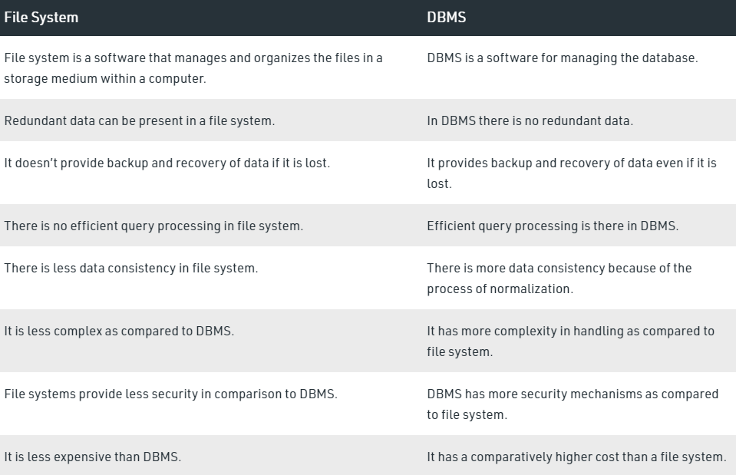
Files vs. Databases

